Slide 2
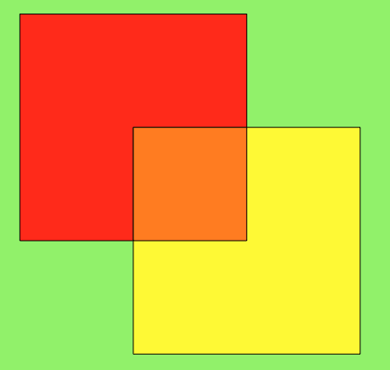
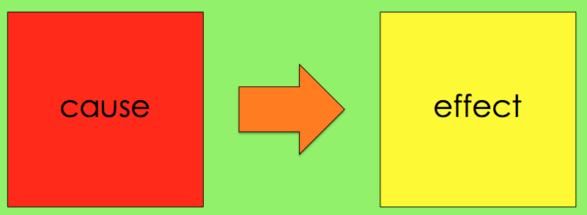
Identifying Text Structure
Nonfiction texts are usually written in one of five structures:
Compare/
Contrast
Description
Sequence
Cause/Effect
Problem/Solution

Slide 3
Identifying Text Structure
Identifying the text structure can help you understand the author’s purpose (or why he/she wrote the text).
It can also help you understand the text better.
Each text structure is organized in a special way and uses key words. Let’s take a look at each text structure.

Slide 4
Description
A description describes each part in logical order.

Slide 5
Description
To identify descriptive text, look for a set of facts about a specific person, place, event, etc.
The text many times begins with a topic sentence that states a main idea. All other sentences support that main idea by providing evidence or details.
A description may give examples and sometimes uses terms like for example or to illustrate.

Slide 6
Description
Let’s look at a descriptive paragraph.
The Ojibwa, a large group of Native Americans who live in Canada and the United States, found many uses for birch bark. They built their homes, wigwams, by covering a rounded frame with bark. Travel across lakes and down rivers was achieved by birch bark canoe. The Ojibwa made storage containers of birch bark. They even recorded their religious beliefs on birch bark scrolls.

Slide 7
Description
Topic Sentence
The Ojibwa, a large group of Native Americans who live in Canada and the United States, found many uses for birch bark.
Detail #1: They built their homes, wigwams, by covering a rounded frame with bark.
Detail #2: Travel across lakes and down
rivers was achieved by birch bark canoe.
Detail #3: The Ojibwa made storage
containers of birch bark.
Detail #4: They even recorded their
religious beliefs on birch bark scrolls.

Slide 8
Sequence
A sequence, or chronology, explains what happened in time order.
Events in a sequence may be placed along a timeline.

Slide 9
Sequence
Here’s a sequential paragraph about the Ojibwa:
As the French entered the Great Lakes region in the 1660s, the Ojibwa began trading with them. Then, to find more furs to trade with the French, the Ojibwa moved westward. During the 1700s and 1800s, they fought with the Dakota over land. In the 1800s the U.S. government sent the Ojibwa to reservations, where the group lives today.

Slide 10
Sequence
Look for words that show order, time, or dates.
Partial History of Ojibwa People, 1600s-1800s
As the French entered the Great Lakes region in the 1660s, the Ojibwa began trading with them.
In the 1800s the U.S. government sent the Ojibwa to reservations, where the group lives today.
Then, to find more furs to trade with the French, the Ojibwa moved westward.
During the 1700s and 1800s, they fought with the Dakota over land.

Slide 11
Compare and Contrast
A compare and contrast structure tells similarities and differences.

Slide 12
Compare and Contrast
This paragraph compares the Ojibwa and Dakota.
The Ojibwa and Dakota shared many customs. They both hunted and fished for food. They built similar boats for transportation, canoes. Likewise, the groups made their own homes. However, the Ojibwa assembled their canoes from birch bark, while the Dakota carved theirs using logs. Their homes were different too. The Ojibwa built wigwams, whereas the Dakota lived in tipis.

Slide 13
Compare and Contrast
Ojibwa
Dakota
They both hunted and fished for food.
They built canoes.
They made their own homes.
The Ojibwa built their canoes of birch bark.
The Ojibwa lived in wigwams.
The Dakota carved their canoes out of logs.
The Dakota lived in tipis.

Slide 14
Compare and Contrast
The Ojibwa and Dakota shared many customs. They both hunted and fished for food. They built similar boats for transportation, canoes. Likewise, the groups made their own homes. However, the Ojibwa assembled their canoes from birch bark, while the Dakota carved theirs using logs. Their homes were different too. The Ojibwa built wigwams, whereas the Dakota lived in tipis.
Since there were more similarities, the author compared first.
She also explained that they were more similar in the topic sentence.

Slide 15
Compare and Contrast
Let’s look for some words that compare, or show similarity.
The Ojibwa and Dakota share many customs. They both hunted and fished for food. They built similar boats for transportation, canoes. Likewise, the groups made their own homes. However, the Ojibwa assembled their canoes from birch bark, while the Dakota carved theirs using logs. Their homes were different too. The Ojibwa built wigwams, whereas the Dakota lived in tipis.

Slide 16
Compare and Contrast
Can you find any words that contrast, or show differences?
The Ojibwa and Dakota share many customs. They both hunted and fished for food. They built similar boats for transportation, canoes. Likewise, the groups made their own homes. However, the Ojibwa assembled their canoes from birch bark, while the Dakota carved theirs using logs. Their homes were different too. The Ojibwa built wigwams, whereas the Dakota lived in tipis.

Slide 17
Cause and Effect
A cause and effect text explores relationships between events and what caused them.
cause
effect

Slide 18
Cause and Effect
Let’s take a look at a cause/effect paragraph.
Treaties with the United States government gave the Ojibwa continued rights to hunt and fish. Unfortunately, this caused problems. From 1989 to 1991, anti-treaty groups held protests against the Ojibwa. Slogans such as “Save a Deer, Shoot an Indian” and “Save a Fish, Spear a Squaw” fueled the disputes.
This paragraph tells some dates, but it does not have a sequential structure. You must read carefully to determine the structure of the entire paragraph.

Slide 19
Cause and Effect
Treaties with the United States government gave the Ojibwa continued rights to hunt and fish. Unfortunately, this caused problems. From 1989 to 1991, anti-treaty groups held protests against the Ojibwa. Slogans such as “Save a Deer, Shoot an Indian” and “Save a Fish, Spear a Squaw” fueled the disputes.
Fortunately, many cause/effect texts use words like cause, because, and effect.

Slide 20
Cause and Effect
In this paragraph, one sentence tells the cause, and three sentences explain the effects.
Unfortunately, this caused problems.
From 1989 to 1991, anti-treaty groups held protests against the Ojibwa.
Slogans such as “Save a Deer, Shoot an Indian” and “Save a Fish, Spear a Squaw” fueled the disputes.
Treaties with the United States government gave the Ojibwa continued rights to hunt and fish.

Slide 21
Cause and Effect
If we look carefully, we can see that there’s only one effect. The author has simply added more details about it.
Cause
Treaties with the United States government gave the Ojibwa continued rights to hunt and fish.
Effect
Anti-treaty groups held protests against the Ojibwa.

Slide 22
Problem and Solution
A problem/solution structure explains a problem and its solution(s).
problem
solution
?
!
?
?
?

Slide 23
Problem and Solution
Here’s a paragraph that explores a problem and its solution.
In the 1990’s, the Ojibwa became concerned that mining practices in White Pine, Michigan, would damage the environment. When they learned that sulfuric acid was being shipped to the mine, members of the tribe made requests for a safety inspection, blocked the railway, and attended public meetings. The mining company faced a long legal battle with the Ojibwa. Consequently, the mine was closed.

Slide 24
Problem and Solution
In the 1990’s, the Ojibwa became concerned that mining practices in White Pine, Michigan, would damage the environment. When they learned that sulfuric acid was being shipped to the mine, members of the tribe made requests for a safety inspection, blocked the railway, and attended public meetings. The mining company faced a long legal battle with the Ojibwa. Consequently, the mine was closed.
Words like problem, solution, finally, so, or consequently may be used in problem/solution texts.

Slide 25
Problem and Solution
Problem/solution texts generally include an explanation of the problem, steps taken to solve the problem, and solution.
problem
solution
mining practices could harm environment
requests
blockade
meetings
mine was closed by company
?
?
?

Slide 26
Let’s Review
A description describes each part in logical order.
To identify descriptive text, look for a set of facts about a specific person, place, event, etc.
A description may give examples and sometimes uses terms like for example or to illustrate.
Description

Slide 27
Let’s Review
A sequence, or chronology, explains what happened in time order.
Events in a sequence may be placed along a timeline.
Look for words that show order, time, or dates.
Sequence

Slide 28
Let’s Review
A compare and contrast structure tells similarities and differences.
Words like both, same, like, too, and in common may be used to compare.
To contrast, words like differ, although, conversely, on the other hand, or yet may be used.
Compare/Contrast

Slide 29
Let’s Review
A cause and effect text explores relationships between events and what caused them.
The text may give more than one cause or effect.
Look for words like because, since, if/then, in order to, for this reason, and therefore.
Cause/Effect

Slide 30
Let’s Review
A problem/solution structure explains a problem and its solution(s).
Problem/solution texts generally include an explanation of the problem, steps taken to solve the problem, and solution.
Words like problem, solution, finally, consequently or so may be used in problem/solution texts.
Problem/Solution

